Slide 1
2.1 Types and methods of data transmission
Packet switching

Slide 2

Packet switching
A data transmission is broken down into packets.
Each packet is assigned a sequence number before being sent.
Each packet can take its own route to the destination based on congestion.
Routers are responsible for controlling the route each packet takes.
Packets may arrive out of order. Once the final packet arrives, they are reordered correctly.
Packet switching can be thought of as a five-step process.

Slide 3
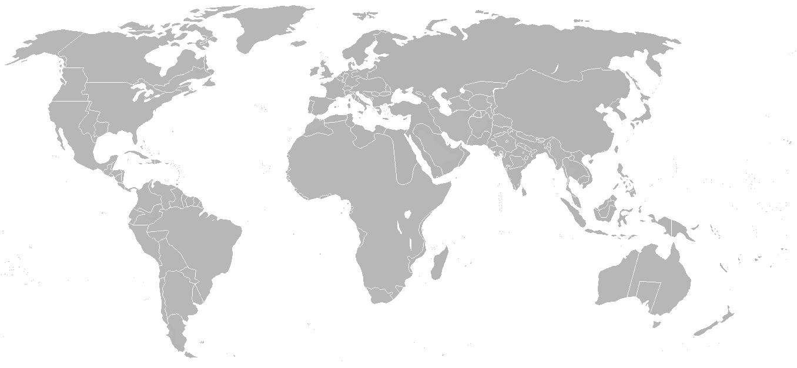

Packet switching
1
2
3
4
Source
Destination

Slide 4




Advantages of packet switching
No need to tie up a single communication channel
Easy to overcome busy or faulty lines by re-routing packets
Possible to achieve a high data transmission rate
Relatively easy to expand package usage

Slide 5
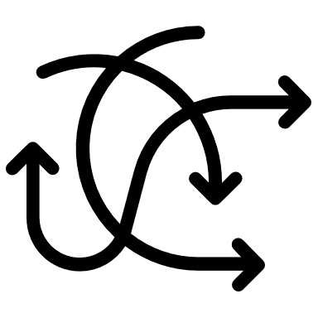


Disadvantages of packet switching
Packet can become lost en route and need to be re-sent
Real-time streaming is more prone to errors
Delays at the destination while packets are re-ordered

Slide 6

Packet switching
Packet switching is a five-stage process:
Data is broken down into packets.
Each packet is assigned a sequence number.
Each packet can take its own route based on congestion.
Routers are responsible for controlling the route each packet takes.
Packets may arrive out of order. Once the final packet arrives, they are reordered.

Slide 7

2.1 Types and methods of data transmission
Going beyond the IGCSE specification

Slide 8

-1
-1
Packet switching
It is possible for packets to get lost because they keep bouncing around from router to router without ever reaching their destination.
To prevent this from happening, we add a hop or time to live field into the header of a packet.
The time to live field is reduced by one every time it leaves a router.
Once the time to live field reaches zero, the packet is deleted when it reaches the next router.
Eventually, the receiving computer will send a request to re-send any missing packets.
4
5
-1
-1
7
6
3
Source
-1
-1
2
1
-1
0
Destination

Slide 9


